Slide 1
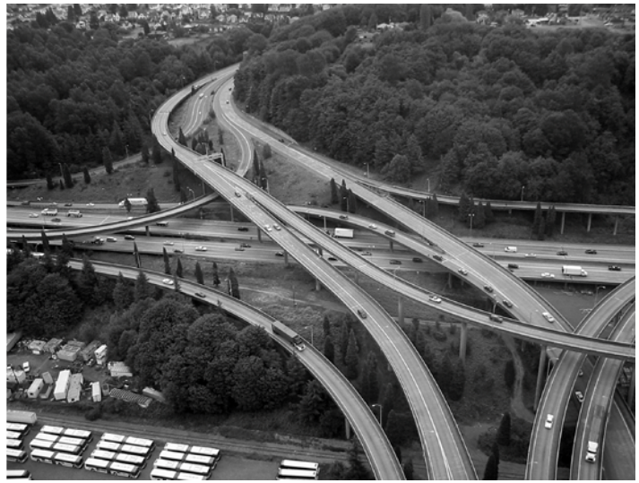
The Art of Project Management:
How to figure out what to do.
«The Art of Project Management» By Scott Berkun

Slide 2
How to figure out what to do
«The hardest single part of building a software system is deciding what to build. No other part of the conceptual work is as difficult in establishing the detailed technical requirements, including the interfaces to people, to machines, and to other software systems. No other part of the work so cripples the result if done wrong. No other part is more difficult to rectify later. Therefore, the most important function that the software builder performs for the client is the iterative extraction and refinement of the product requirements.»
                Fred Brooks

Slide 3
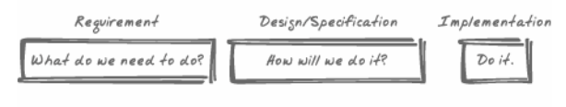
If you don't know what you need to do, it's too early to figure out how to do it

Slide 4
Different types of projects
Solo-superman. In the simplest project, only one person is involved, he does everything himself and is his own source of funding.
Small contract team. A firm of 5 or 10 programmers and 1 manager is hired by a client to build a web site or software application. They draft a contract that defines their commitments to each other.
Big staff team. A 100-person team employed by a corporation begins work on a new version of something. It might be a product sold to the public or something used internally.

Slide 5
Different types of projects
Who has requirements authority? Someone has to define the requirements and get them approved by the necessary parties (client or Vice President). There may be different people with high-level requirements authority («it will be a sports truck») and low-level requirements authority («it will get 20 mpg and have 4-wheel drive»)
Who has desing authority? Similar to requirements, someone has to define the design of work itself. The design is different from the requirements because there are always many different possible designs to fulfill a set of requirements.

Slide 6
Different types of projects
Who has technical authority? Technical authority is defined by who gets to choose which engineering approaches are used, including programming languages, development tools, and technical architecture.
Who has budged authority? The ability to add or remove resources to a project can be independent from other kinds of authority. In the contract team situation, the team might have the power to define the requirements and design, but they might need to return to the client each time they want more money or time.

Slide 7
Different types of projects
How often will requirements and desings be reviewed, and how will adjustments be decided? The answer depends heavily on previous questions. The more parties involved — the more effort will need to be spent keeping them in sync. The less authority you have, the more diligent you need to be about reviewing and confirming decisions.

Slide 8
Planning deliverables
Marketing requirements document (MRB). This is businesss or marketing team's analysis of the world. The goal is to explain what business opportunities exist and how a project can exploit those opportunities.
Vision/scope document. A vision document defines the goals of a project, why they make sence, and what the high-level features, requirements, or dates for a project will be.
Specifications. These capture what the end result of the work should be for one part of the project. Specifications define «how» of a project from a design and engineering perspective.

Slide 9
Planning deliverables
Work breakdown structure (WBS). While specification details the work to be done, a WBS defines how a team of engineers will go about doing it. What work will be done first? Who will do it? How can we track them? WBS can be spreadsheet or very complex (charts and tools).

Slide 10
The three perspectives. Business
Each of the deliverables mentioned earlier represents one of two perspectives on the project: business or engineering.
The business view focuses on things that impact the profit and loss (P&L):
What unmet needs or desires do our customers have?
What features or services might we provide that will meet those desires and needs?
On what bases will customers purchase this product or service? What will motivate them to do so?
What will it cost (people/resources)? Over what time period?

Slide 11
The three perspectives. Business
What potential for revenue (or reduced organizational operating costs) does it have? Over what time period?
What won't we build so that we can build this?
Will it contribute to our long-term business strategy or protect other revenue-generating assets?
How will this help us match, outflank, or beat competitors?
What are the market time windows that we should target for this project?
Marketing: product, price, placement, promotion.

Slide 12
The three perspectives. Technology
Technology perspective is not the customer's perspective
What does it (the project) need to do?
How will it work? How will each of the components in it work?
How reliable, efficient, extensible, and performant are the current systems or ones we are capable of building?
What engineering processes and approaches are appropriate for this team and this project?
What applicable knowledge and expertise do our people have?
How will we fill gaps in expertise? (Train/hire/ignore/hope on magic)

Slide 13
The three perspectives. Customer's
What the customers do, how they do it?
What do people actually do? (Not what we think they do or what they say they do)
What problems do they have trying to do these things? Stuck, confuse?
What do they need or want to do but aren't able to do at all?
Where are the specific opportunities to make things easier, safer, faster, or more reliable?
What design ideas for how to improve?
How can those ideas be explored?
What core ideas and concepts should the project use?

Slide 14
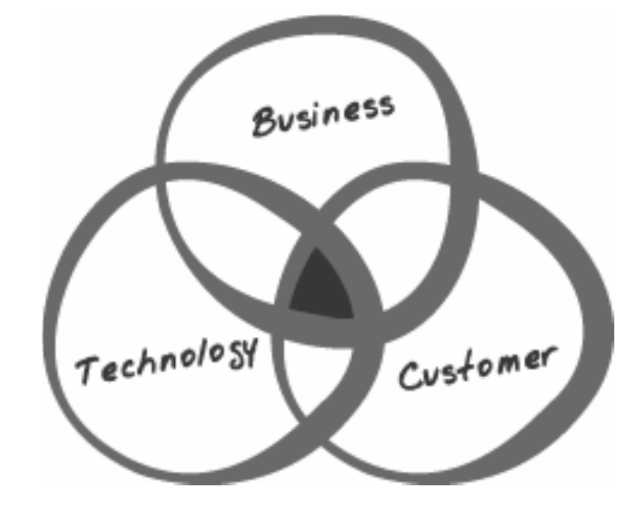
The magical interdisciplinary view
Power balance

Slide 15
The three perspectives
«Years ago, I was involved in one of these silly wars myself. I was the program manager fo r web-search features on Internet Explorer 4.0. Two business development people were assigned to us, and they were negotiating deals with the major search engines of the time (Excite, Yahoo!, Lycos, AltaVista, etc.). We argued with these business experts over design decisions, continually debating over what was best for the customer versis what was best for the business. We each believed that we held the authority (I spoke the design/engineering staff, and they provided the business arguments). We argued on the same points for weeks, always debating the specific decisions and never stepping back to evaluate our hidden philosophies on what made for good products...

Slide 16
The three perspectives
.. Things got so bad that we brought in our group manager to help us reach a compromise.
I'm convinced a broader view of the world would have helped everyone involved. We were all so invested in our egos and beliefs that we were willing to spend tons of time fighting over tiny points, instead of working to understand all of the perspectives on what we were building. A better vision document could have helped, but that was impossible because the business challenges of the Internet were so new to the industry (1997). However, had we been sharing each other's knowledge, instead of resisting it, we might have a shot at finding a mutually benefical compromise.
When you're looking for the best solutions, they won't always correspond to what you're good at doing, or which ideas you personally prefer.»

Slide 17
Right questions
The simplest way to frame planning work is to define a set of questions that the planning work needs to answer.
What are the 3 or 4 customer grouping we can use to discuss different kinds of customers? How do their needs and behaviors differ?
What demographic information can help us? (Age, income, profession, education, etc.)
Which activities is each user group using our product for? How does this correspond to what they purchased the product for?
Who are our potential new customers, and what features, scenarios, or types of products would we need to provide?

Slide 18
Right questions
Do we have the technology and expertise to create something that satisfies these needs and problems? (For each identified need, answers of yes, maybe, and no)
Can we build technology and obtain the expertise to create something thaat satisfies these needs and problems?
Are there viable business models for using our expertise and technology to solve these identified problems or needs?
What are the market timelines for the next release or product launch?
What are competitors in this marketplace doing?

Slide 19
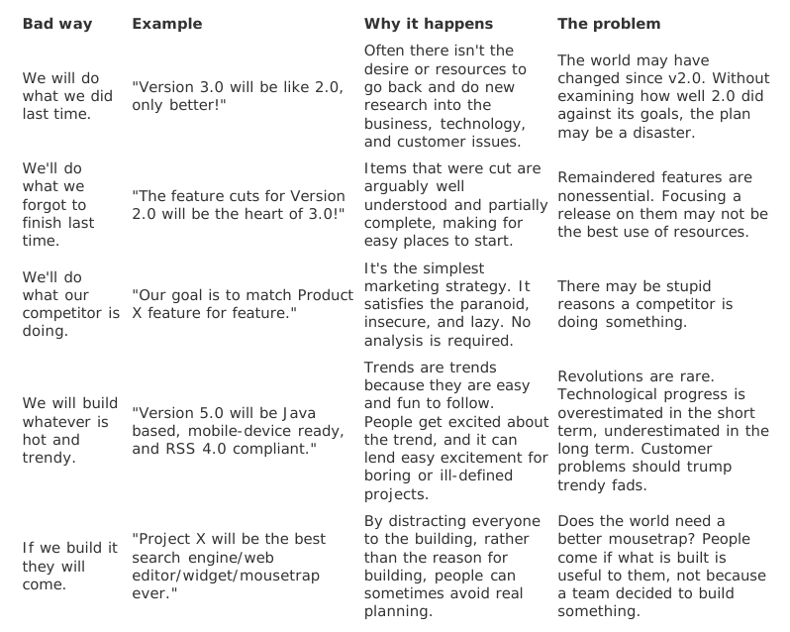
Bad ways to decide what to do

Slide 20
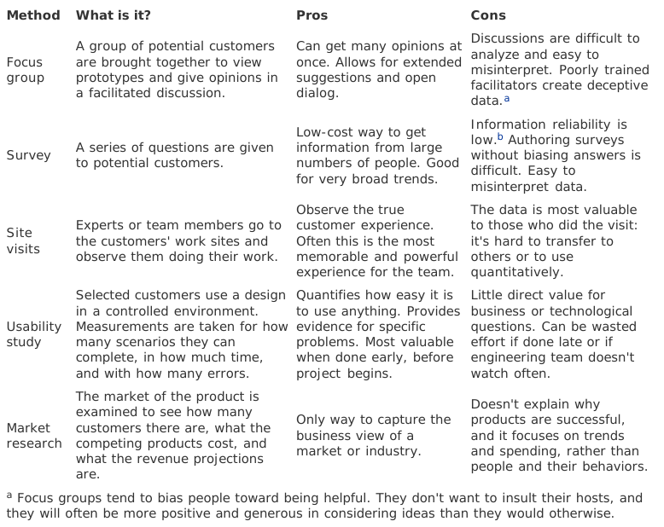
Common customer research methods

Slide 21
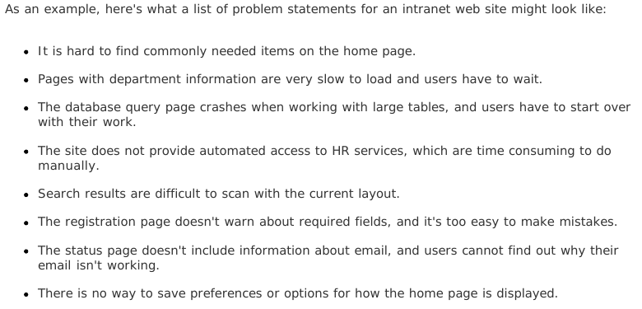
Bringing all together

Slide 22
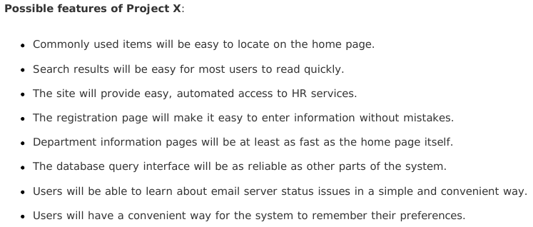
Bringing all together

Slide 23
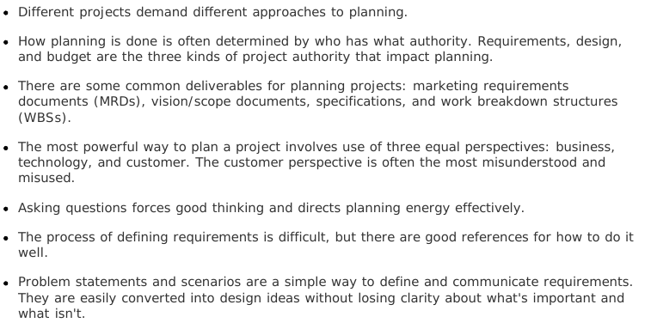
Summary

